Slide 1
Lesson 22 – Gradle, CI/CD

Slide 2
Lesson Goals
Gradle
Continuous Integration
Continuous Delivery
Spring Boot Useful Features
Monitoring

Slide 3

What is

Slide 4
Software build process
Building software is hard and require big amount of time!

Slide 5
Software build process
Building software is hard and require big amount of time!
Software build process:
Develop
Test
Assemble
Deploy
Integrate
Repeat
Again and again and again… 🤪

Slide 6
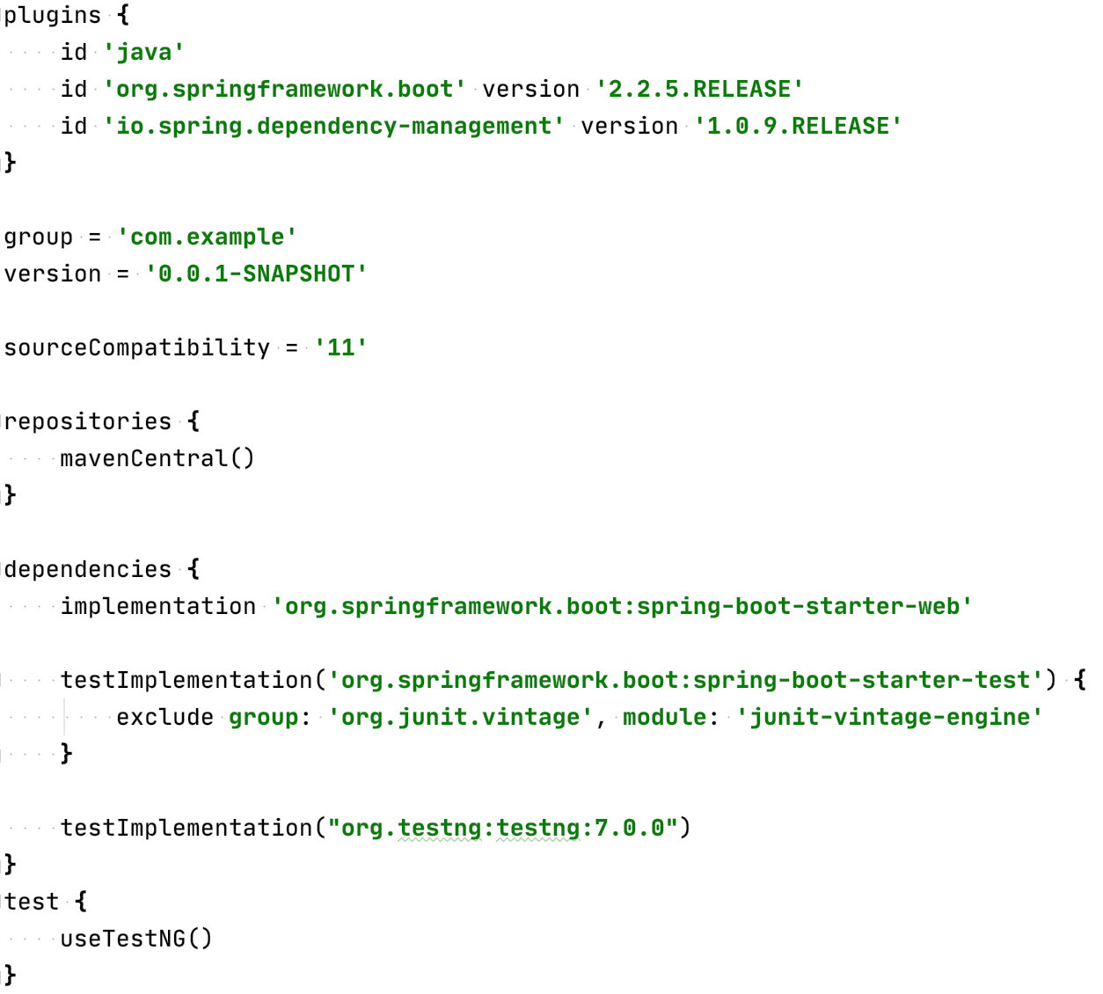
Gradle Project Config Example

Slide 7
Gradle main points
Can use Wrapper instead separate instalation in system 😍
Build Scripts are code in Groovy/Kotlin DSL 😎
Pluggable to work not only with Java 😉
Flexible build configurations(declarative style) 🙃
Some times called “StackOverflow driven build system” 🤕

Slide 8
Gradle core concepts
Build script: a build.gradle configuration script supporting one or more projects.
Project: a component that needs to be build. It is made up of one or more tasks.
Task: distinct step required to perform the build.

Slide 9
Gradle core concepts
Publication: the artifact prooduced by the build process.
Dependencies: tasks and projects depending on each other (internal) or on third-party artifacts (external).
Transitive dependencies: the dependencies of a project may themselves have dependencies.

Slide 10
Gradle core concepts
Repositories: the “places” that hold external dependencies.
Dependency Graph: shows what depends on what.
Plugins: external tools that can customize build process

Slide 11
Gradle Plugin power
Add a task to a project
Pre-configure these tasks with reasonable defaults
Add dependency configurations
Add new properties and methods to existing objects

Slide 12
Gradle Project Config Example

Slide 13
The Build Lifecycle
Initialization: initialization of the project
Configuration: configuration of the project (computes the dependencies graph)
Execution: executes the sequence of build tasks

Slide 14
Multi Module Projects
Each module/project with its own “build.gradle”
Each module described in “settings.gradle” file in the root of project folder
Root project “build.gradle” should contain only configs related to all or subprojects

Slide 15
Gradle Example
Show Gradle Tool in IDEA
Show Dependency Graph
Execution of tasks from command line
Multi module project structure
Multiple projects configuration (subprojects)
JAR building

Slide 16
What is CI/CD

Slide 17
Continuous Integration Process
Detects errors as quickly as possible: fix problems while fresh in developers mind
Reduces integration problems: smaller problems are easier to fix
Avoid compounding problems: allows teams to develop faster, with more confidence

Slide 18
Continuous Delivery Process
Ensures every change is releasable: test everything, including deployment, before calling it done
Lowers risk of each release: makes releases “boring”
Delivers value more frequently: reliable deployments mean more releases
Tight customer feedback loops: fast and frequent customer feedback on changes

Slide 19
How it works

Slide 20
Basic CI/CD flow

Slide 21
Detail CI/CD flow

Slide 22
CI/CD provider for projects

Slide 23
GitLab pipeline glossary
Commit: A code change.
Job: Instructions that a runner has to execute.
Pipeline: A collection of jobs split into different stages.
Runner: An agent or server that executes each job individually that can spin up or down as needed.
Stages: A keyword that defines certain stages of a job, such as build and deploy. Jobs of the same stage are executed in parallel.

Slide 24
GitLab CI/CD flow example
Pipelines are configured using a version-controlled YAML file, .gitlab-ci.yml, within the root of a project.

Slide 25
.gitlab-ci.yml example
image: adoptopenjdk/openjdk11:latest stages: - build - deploy before_script: - chmod +x gradlew build: stage: build script: ./gradlew build artifacts: paths: - target/demo-0.0.1-SNAPSHOT.jar production: stage: deploy
image: ruby:latest script: - …
only: - master

Slide 26
So CI is done, but what about CD
Heroku as a prod server/hosting provider
Postgre DB with 10000 rows limit
Getting started with Gradle on Heroku

Slide 27
CI/CD Example on real app
Show CI with failed pipeline
Make a code fix
Push changes
Wait for CI/CD
Check that all works fine

Slide 28
Spring Boot Useful Features

Slide 29
Spring Boot Profiles

Slide 30
Profiles code usage
public interface DatasourceConfig { void setup(); }
@Component @Profile("dev") public class DevDatasourceConfig implements DatasourceConfig { @Override public void setup() { System.out.println("Setting up datasource for DEV environment. "); } } @Component @Profile("production") public class ProductionDatasourceConfig implements DatasourceConfig { @Override public void setup() { System.out.println("Setting up datasource for PRODUCTION environment. "); } }

Slide 31
Profiles code usage
public interface DatasourceConfig { void setup(); }
@Component @Profile("dev") public class DevDatasourceConfig implements DatasourceConfig { @Override public void setup() { System.out.println("Setting up datasource for DEV environment. "); } } @Component @Profile("production") public class ProductionDatasourceConfig implements DatasourceConfig { @Override public void setup() { System.out.println("Setting up datasource for PRODUCTION environment. "); } }

Slide 32
Profiles Example in IDE
Profile configuration
Missing prod bean in dev config
Set profile from IDE, command line arg (-Dspring.profiles.active=profile)
Profiles config via *-profile.properties

Slide 33
Spring Boot Actuator 2.X
Actuator brings production-ready features to our application:
Monitoring our app
Gathering metrics
Understanding traffic
And many more…

Slide 34
Some of predefined endpoints
/beans – returns all available beans in our BeanFactory. Unlike /auditevents, it doesn't support filtering
/configprops – allows us to fetch all @ConfigurationProperties beans
/env – returns the current environment properties. Additionally, we can retrieve single properties
/flyway – provides details about our Flyway database migrations
/health – summarises the health status of our application
/info – returns general information. It might be custom data, build information or details about the latest commit
/logfile – returns ordinary application logs

Slide 35
Some of predefined endpoints
/metrics – details metrics of our application. This might include generic metrics as well as custom ones
/scheduledtasks – provides details about every scheduled task within our application
/shutdown – performs a graceful shutdown of the application
/threaddump – dumps the thread information of the underlying JVM
/heapdump – builds and returns a heap dump from the JVM used by our application

Slide 36
Summary: All of that is DevOps

Slide 37
Additional topics to investigate
Code quality check (V)
Code coverage tracking (V)
Sentry for error tracking (V)
Metrics usage with Prometheus and Grafana
Distributed Tracing (with Zipkin or etc)
Alert management via messengers or email
SonarCloud (free for OpenSource)

Slide 38
Homework Task (Gradle)
Create a separate Gradle child module “codec” for parent module “Homework”
Move only Codec functionality (under ”org.geekhub.crypto.coders” package) like classes, resources, etc to ”codec” module
Inlcude “codec” module into “Homework” module as a Gradle dependency

Slide 39
Course Work Task 1 (CI)
Add support of CI/CD by using Gitlab CI
Create and configure 3 stages:
build – used for building our application
test – used for running tests
deploy – used for delivering our application to prod on Heroku (required custom variable HEROKU_API_KEY setup on GitLab CI/CD settings )

Slide 40
Course Work Task 2 (CD)
Setup Course work application on Heroku with name with pattern “bwayne-crypto” (first letter of first name, last name, -, crypto)
Use https://github.com/heroku/gradle-getting-started and https://devcenter.heroku.com/articles/git#for-an-existing-heroku-app for additional info during setup
Add support of Postgre DB as a production DB
Create “prod” profile that will contains config to Heroku DB
Use “prod” profile on Heroku
Local application should work with “H2” embedded DB by default

Slide 41
Course Work Task 3 (DevOps)
Add Spring Boot Actuator dependency
Allow access to actuator endpoints only for SUPER_ADMIN
Enable /shutdown endpoint
Enable /metrics endpoint
Enable other endpoints on your taste)
*Configure actuator on a separate port

Slide 42
Course Work Task 4 (DevOps) [OPT]
https://sentry.io
https://sentry.io/for/spring/
https://github.com/getsentry/sentry-java/tree/master/sentry-spring-boot-starter

Slide 43
Literature
Building Spring Boot 2 Projects With Gradle
Continuous Integration
GitLab Deploy Spring Boot Example
Deploying Spring Boot Apps to Heroku
Getting started with Gradle on Heroku
Spring Boot Actuator
Spring Profiles

Slide 44
Thanks!
Any Questions?
Or find us in Slack:
@Yaroslav Brahinets
@Vasya Rudas
@Oleksandr Kucher

